Slide 1
Understanding class and object definitions
Looking inside classes and exploring source code
6.0
Notes:
Replace this with your course title and your name/contact details.

Slide 2
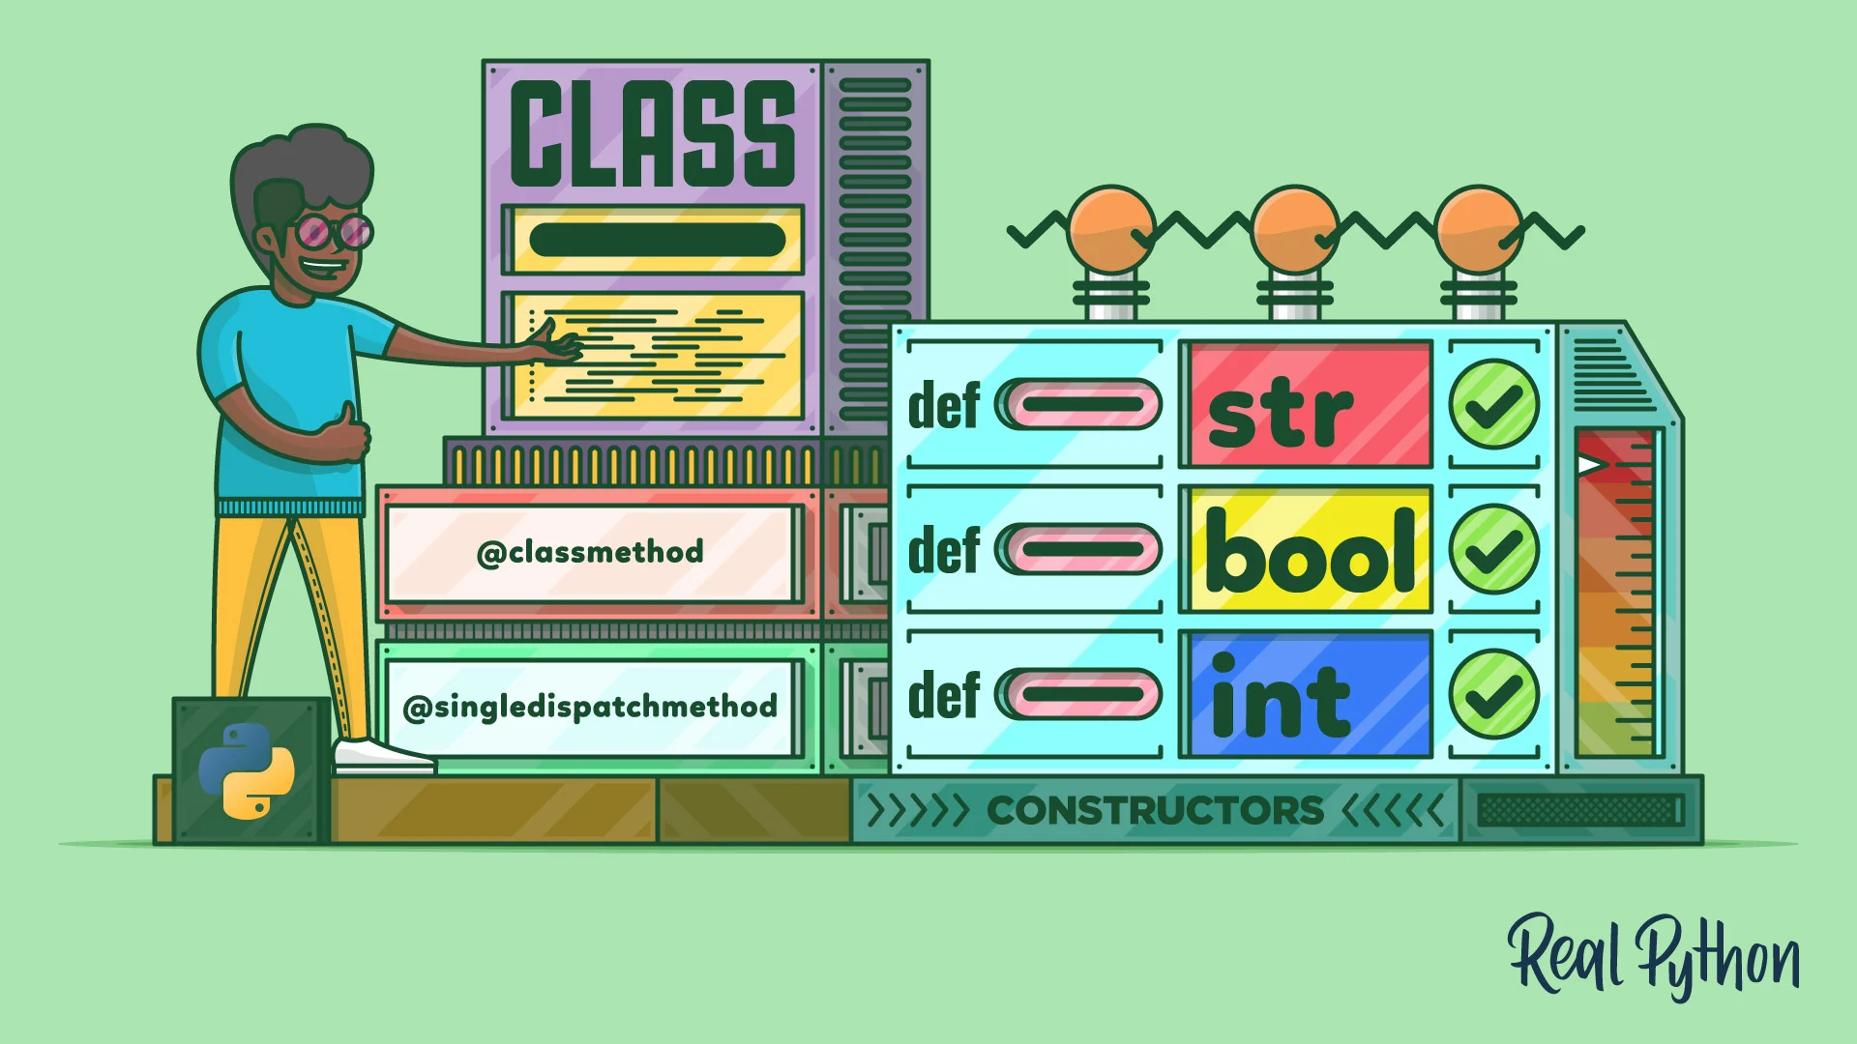
Fundamental concepts
Class
Object
Method
Parameter
Data type

Slide 3
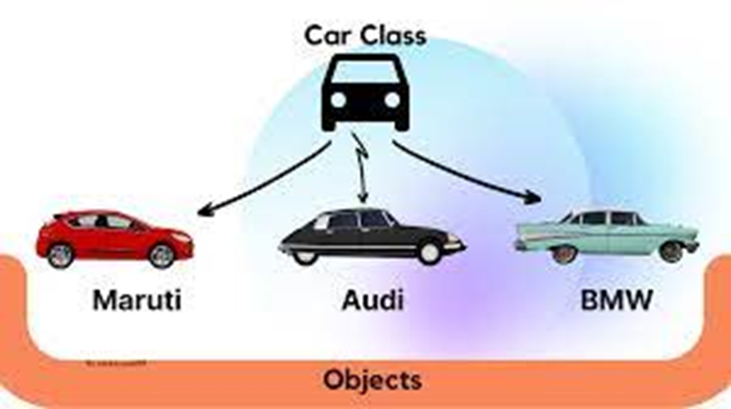
Classes and objects
Class: category or type of ‘thing’ (Like a template)
or Blueprint.

Slide 4
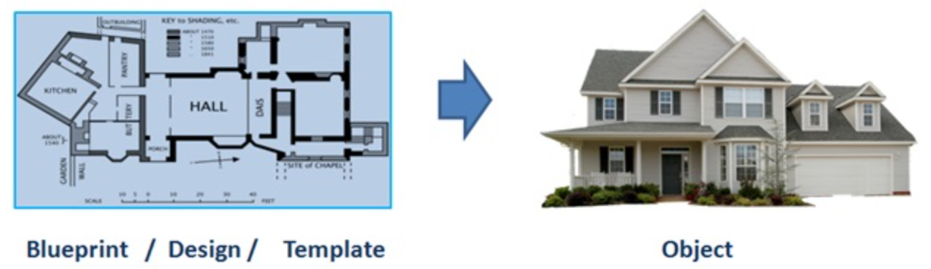
Blueprint
A blueprint is a guide for making something.
— it's a design or pattern that can be followed.

Slide 5
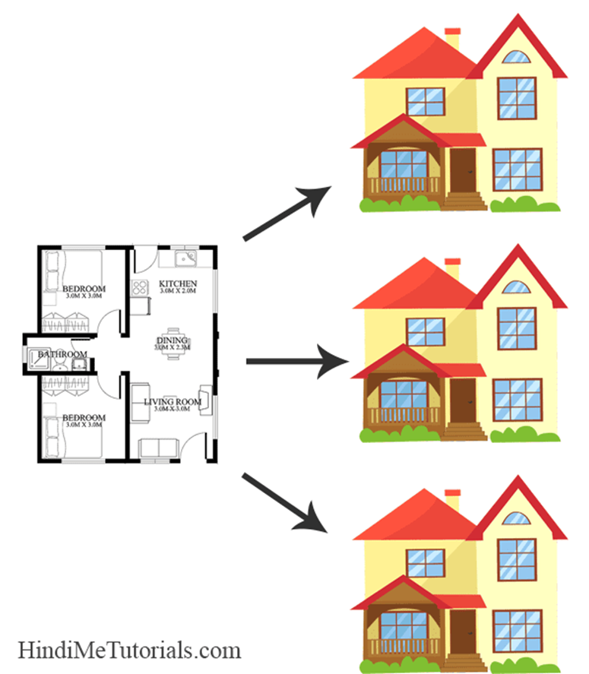
Object: belongs to a particular class and has individual characteristics

Slide 6
Classes and Objects
A class is a template definition of the methods and variables in a particular kind of object.
An object is a specific instance of a class
Containing real values instead of variables.

Slide 7
Classes and Objects
Classes (noun)
Represents ALL generic objects of a similar kind or type
e.g. Car
Objects (proper noun)
Represents ONE specific thing from the real world or some problem domain.
e.g. THAT red car in the garage or YOUR green car in the parking

Slide 8
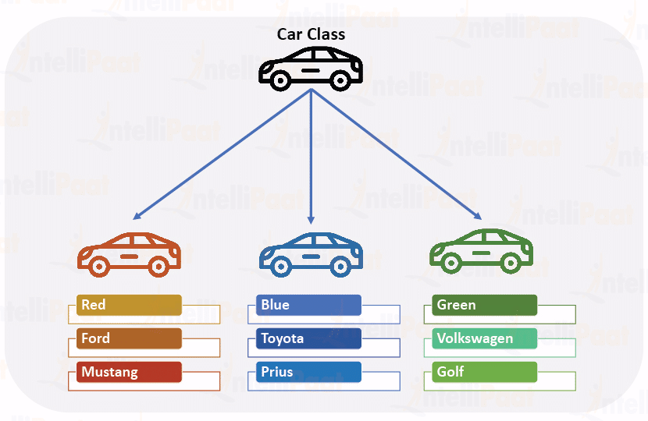
Color
Factory
Type

Slide 9
Methods and Parameters
Methods (verbs)
Operations which can be invoked on a specific object.
e.g. drive the red car
Parameters (adverbs)
Additional necessary information may be passed to the method to help with its execution.
e.g. drive the red car for 10 miles

Slide 10
Other observations
Many distinct instances can be created from a single class.
An object has attributes that their values stored in fields.
The class defines what fields an object has.
Each object stores its own set of VALUES (the state of the object)

Slide 11
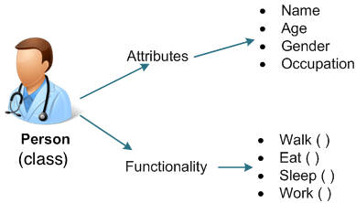
Objects
Class
(fields)
Class:
(methods)
Defines the structure (number, types) of the attributes.
Defines available behaviors of its objects.

Slide 12
Demo of figures project
Here, we start discussing objects and classes in an shapes example in BlueJ.
All important points of this lecture are encountered and pointed out during this demo.

Slide 13
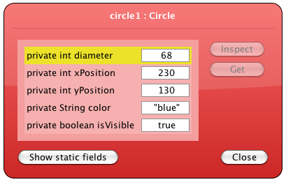
State

Slide 14
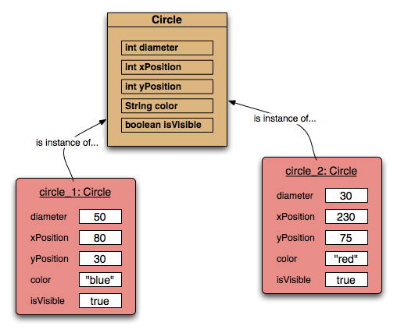
Two circle objects
75
30
80
230

Slide 15
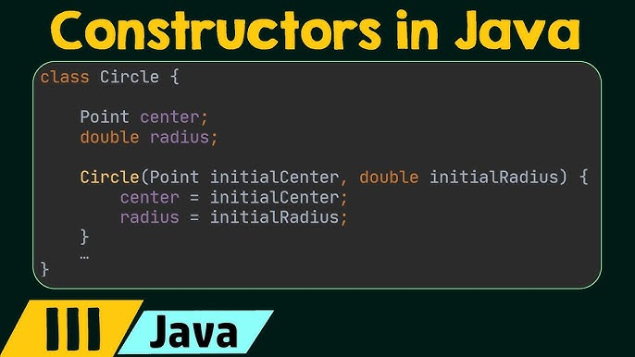
Source code
Each class has its own JAVA source code associated with it that defines its details (attributes and methods)

Slide 16
Return values
The methods in the figures project have void return types.
But methods may return a result via a return value that is not void.
Such methods will have a specific non-void return data type

Slide 17
Ticket machines
Demo of
naïve-ticket-machine

Slide 18
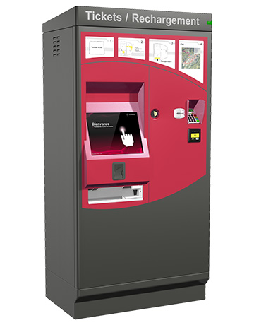
Ticket machines
Exploring the behavior of a typical ticket machine using naive-ticket-machine project.
It supplies tickets of a fixed price.

Slide 19

An external view
How is that price determined?
How does a machine keep track of the money that is entered so far?
How does a machine keep track of the total amount of money collected?
How is ‘money’ entered into a machine?
How does the machine issue the ticket?

Slide 20
An internal view
Looking inside allows us to determine how the object’s behavior is provided or implemented.
All Java classes have a similar-looking internal view.

Slide 21
Basic class structure
The outer wrapper of TicketMachine
public class TicketMachine
{
Inner part omitted
}
public class ClassName
{
Fields
Constructors
Methods
}
The inner contents of a class

Slide 22
Constructors
A constructor is a special method of a class that initializes a newly created object of that type.
Whenever an object is created, the constructor is called automatically.
public class MyClass
{
//This is the Constructor
MyClass()
{
//Constructor body
}
}

Slide 23
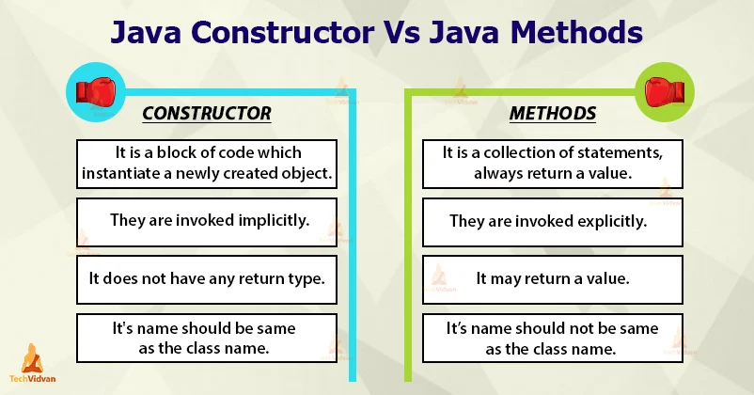
Constructors Vs Methods

Slide 24
Keywords
Words with a special meaning in the language:
public
class
private
int
Also known as reserved words
Always entirely lower-case

Slide 25
Fields
Fields store values for an object.
instance variables.
Fields define the state of an object.
Some values change often.
Some change rarely (or not at all)
public class TicketMachine
{
private int price;
private int balance;
private int total;
Further details omitted.
}
type
visibility modifier
variable name
private int price;

Slide 26
Visibility
Private members
Are used for attributes, methods and constructors, making them only accessible within the declared.
Public members
Can be accessed by any object.
Provide abstract view (client-side).
Protected members
Can be accessed by instances of the same class and its subclasses.
Default
Whenever a specific access level is not specified
Can be accessed within the package.
A java package is a group of similar types of classes, interfaces and sub-packages.

Slide 27
An Example
public class Main {
final int x = 10;
final double PI = 3.14;
public static void main(String[] args) {
Main myObj = new Main();
myObj.x = 50; // will generate an error: cannot assign a value to a final variable
myObj.PI = 25; // will generate an error: cannot assign a value to a final variable
System.out.println(myObj.x);
}
}

Slide 28
Access modifiers for a class
public:
The class is accessible by any other class.
default:
Also known as package private and is used when you don't specify a modifier.
The class is only accessible by classes in the same package. We will learn about this later.
private:
Can only be used for inner classes.

Slide 29
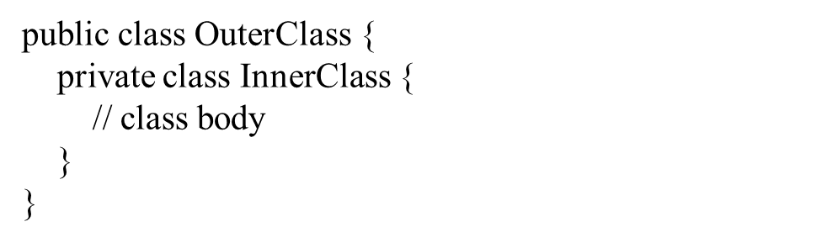
A private inner class is a nested class that is defined within another class and is accessible only from within its enclosing class.

Slide 30
Creating an object
Primitive types:
Objects:
int myAge = 20;
double myBloodPressure = 11.8;
public class Car
{
…
}
Car myCar = new Car();
Car myFatherCar = new Car(1398);

Slide 31
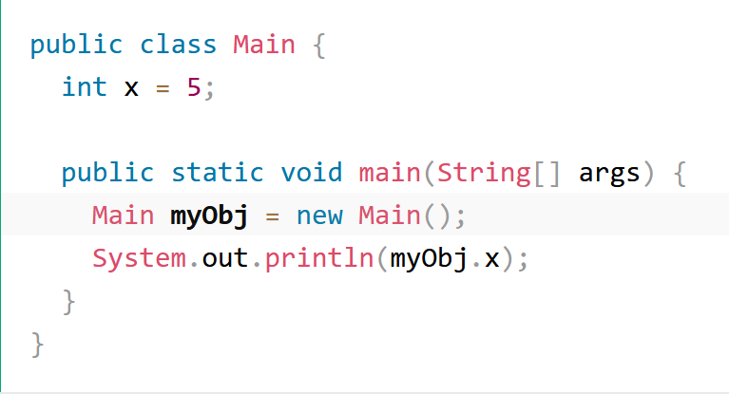
Creating an object (cont.)
To create an object of Main:
specify the class name,
followed by the object name, and
use the keyword new

Slide 32
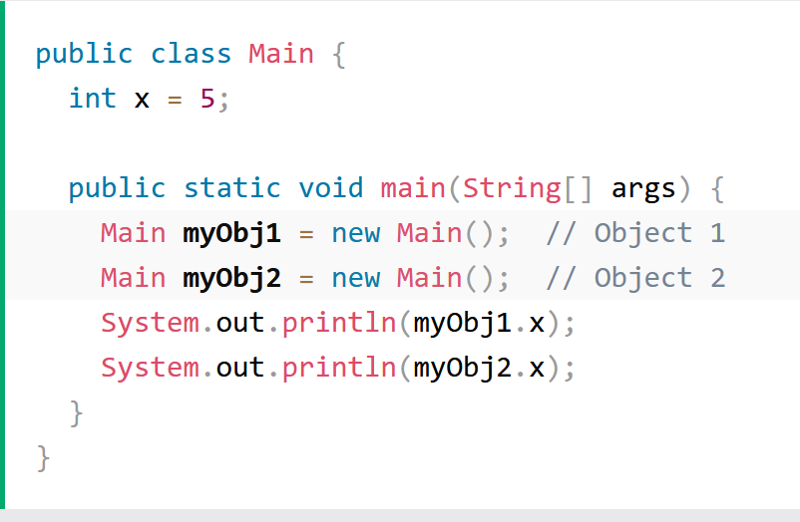
Multiple objects
We can create multiple objects of one class

Slide 33
Multiple classes (cont.)
We can also create an object of a class and access it in another class.
Using for better organization of classes
One class has all the attributes and methods, while the other class holds the main() method (code to be executed).

Slide 34
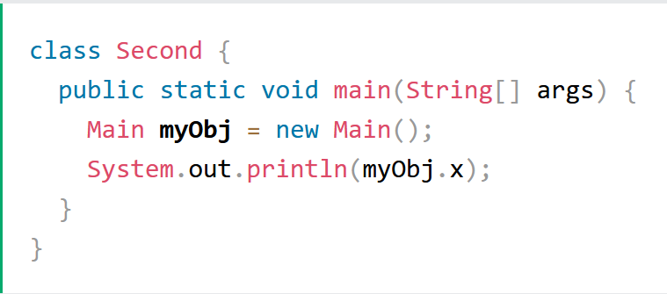
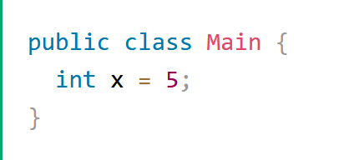
Multiple Classes (cont.)
Remember that the name of the java file should match the class name.
We create two files in the same directory/folder:
Main.java
Second.java
Main.java
Second.java

Slide 35
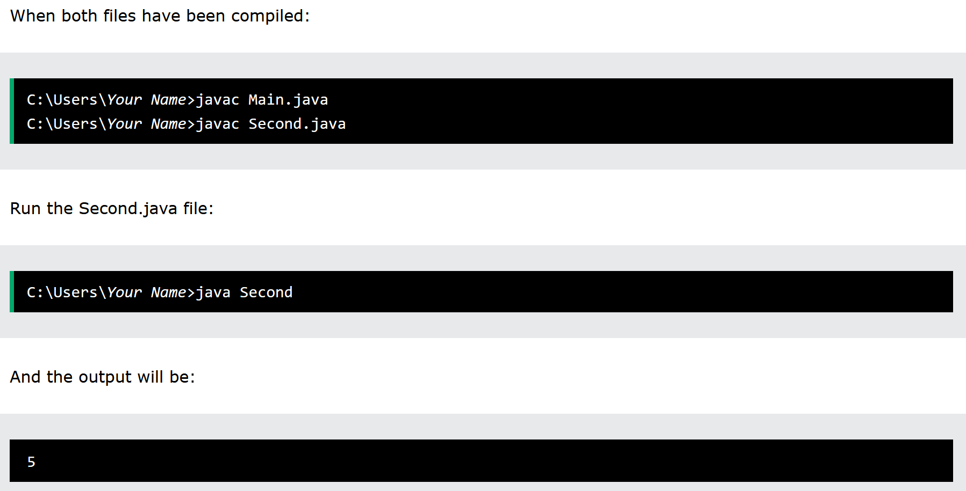
Multiple classes (cont.)

Slide 36
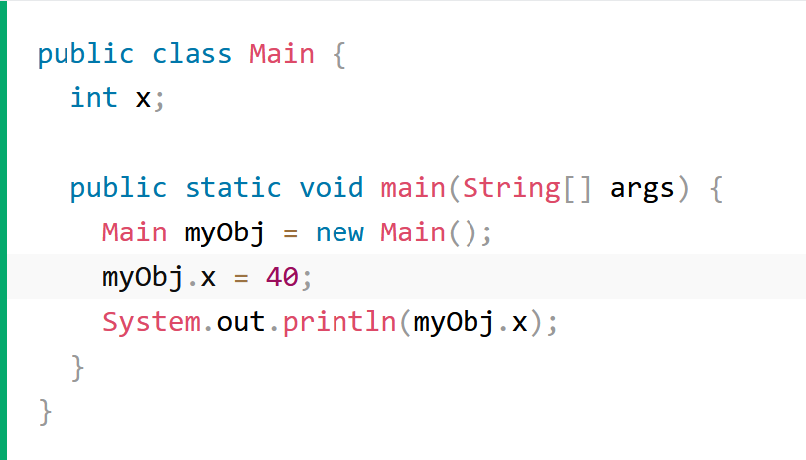
Modify Attributes

Slide 37
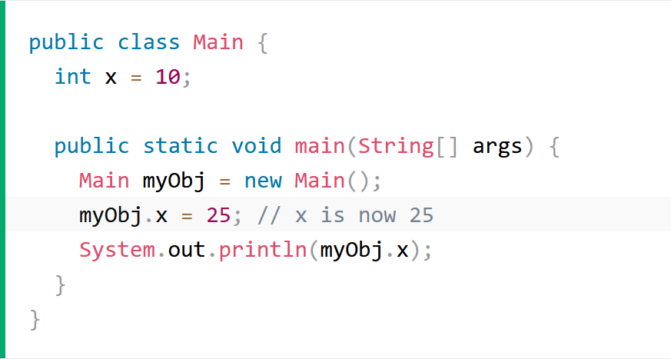
override existing values

Slide 38
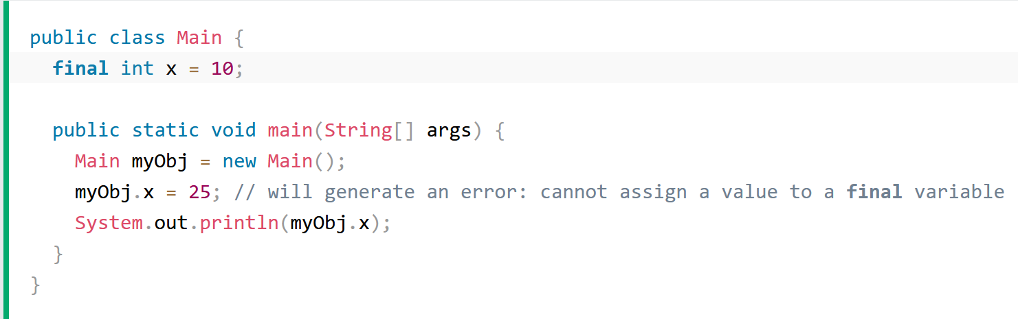
Deprivation of ability to override
The final keyword is useful when you want a variable to always store the same value, like PI (3.14159...).

Slide 39
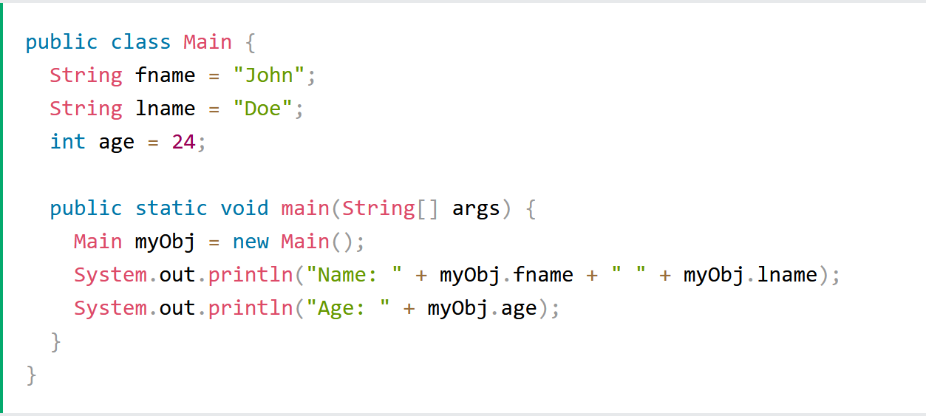
Multiple attributes

Slide 40
Methods in Java
Why use methods?
A method is a block of code which only runs when it is called.
We can pass data, known as parameters, into a method.
Methods are used to perform certain actions, and they are also known as functions.
To reuse code:
define the code once, and use it many times.

Slide 41
Method structure
The header provides the method’s signature:
public int getPrice()
The header tells us:
the visibility to objects of other classes (e.g. public, private or protected)
whether the method returns a result
the name of the method
List of parameters

Slide 42
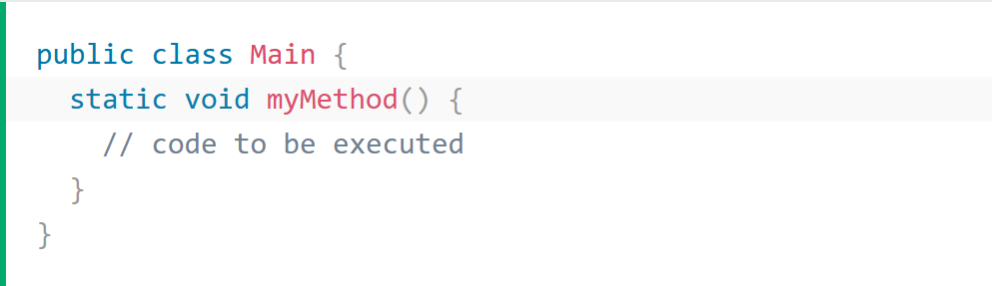
Create a method
A method must be declared within a class.
myMethod() is the name of the method.
Static means that the method belongs to the Main class and not an object of the Main class.
Void means that this method does not have a return value.

Slide 43
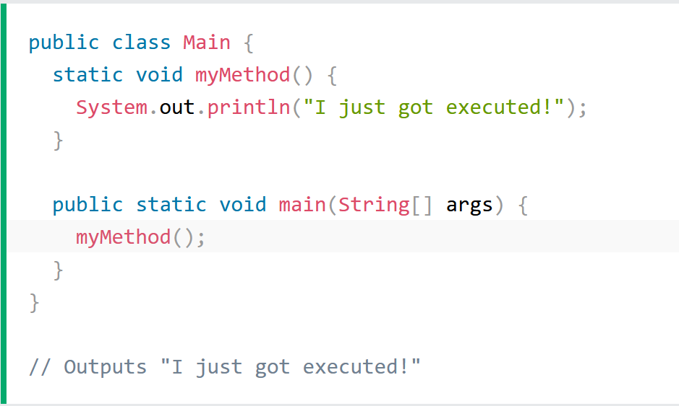
Call a method
A method can be called multiple times.

Slide 44
Java Method Parameters
Information can be passed to methods as parameter.
Parameters act as variables inside the method.
We can add as many parameters as you want, just separate them with a comma.
When a parameter is passed to the method, it is called an argument.

Slide 45
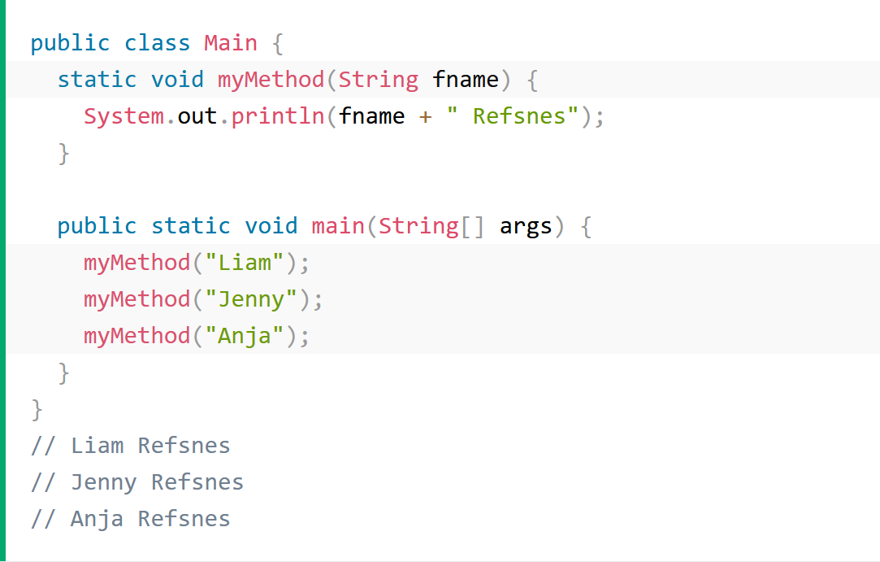
Parameters and Arguments

Slide 46
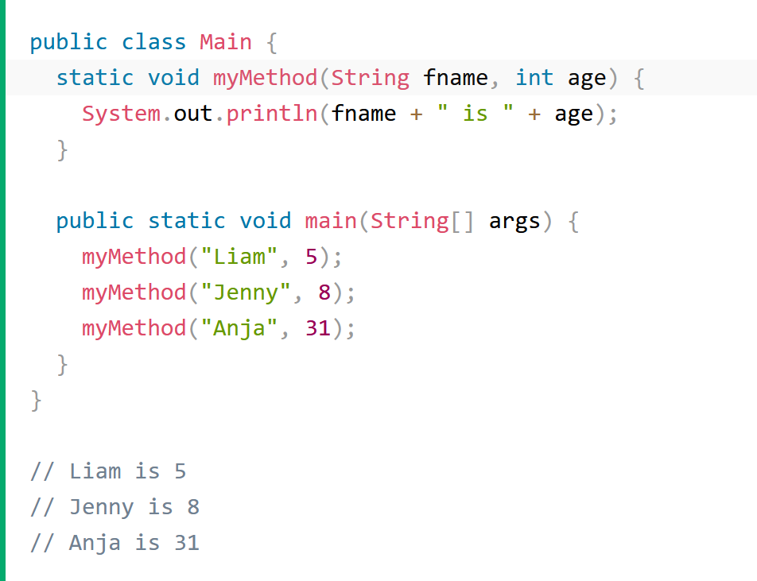
Multiple parameters

Slide 47
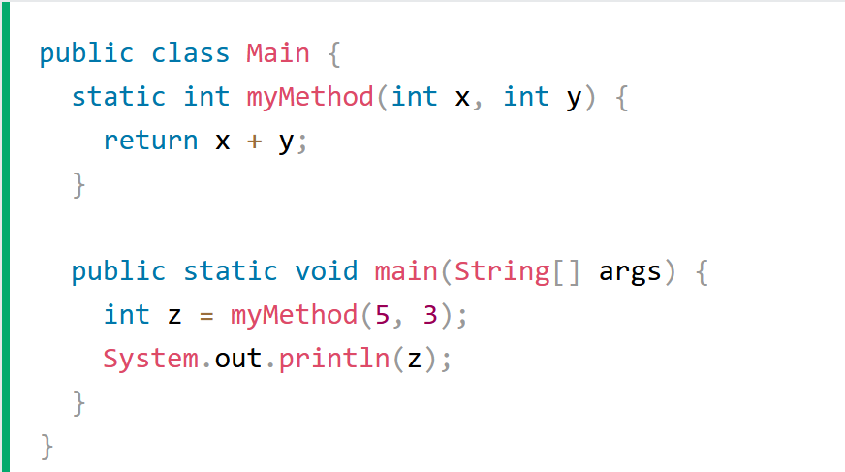
Storing the results
We can also store the output of a method in a variable

Slide 48
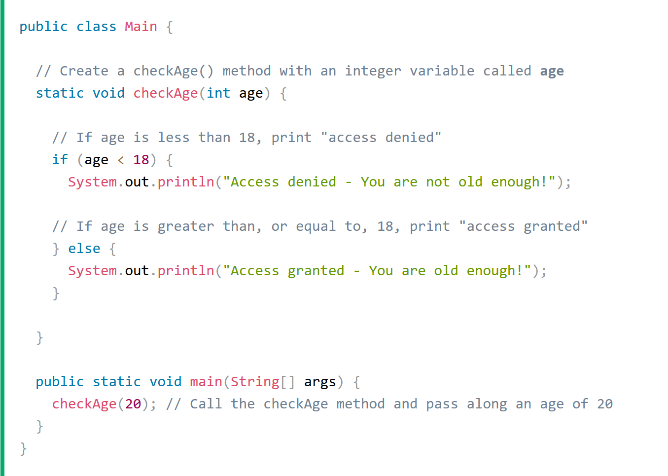
A Method with If...Else

Slide 49
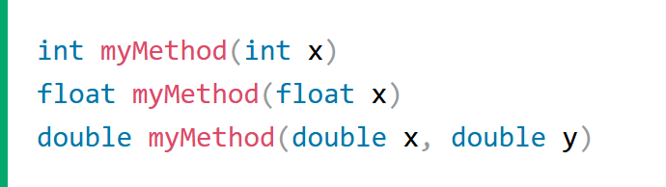
Method Overloading
With method overloading, multiple methods can have the same name with different parameters:

Slide 50
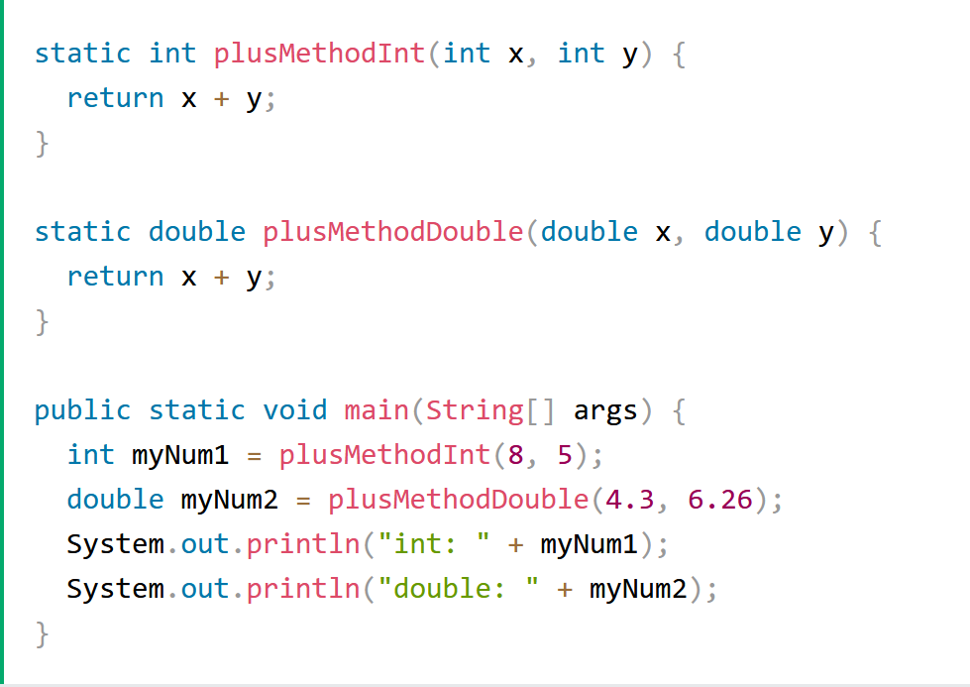
Instead of defining two methods that should do the same thing, it is better to overload one.

Slide 51
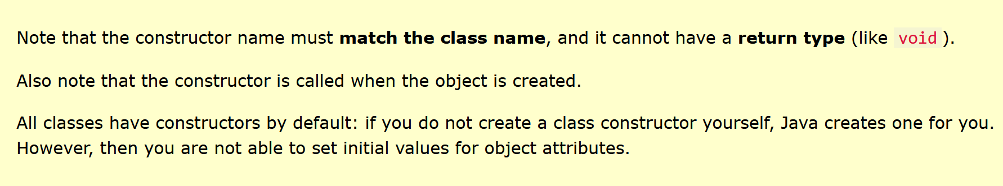
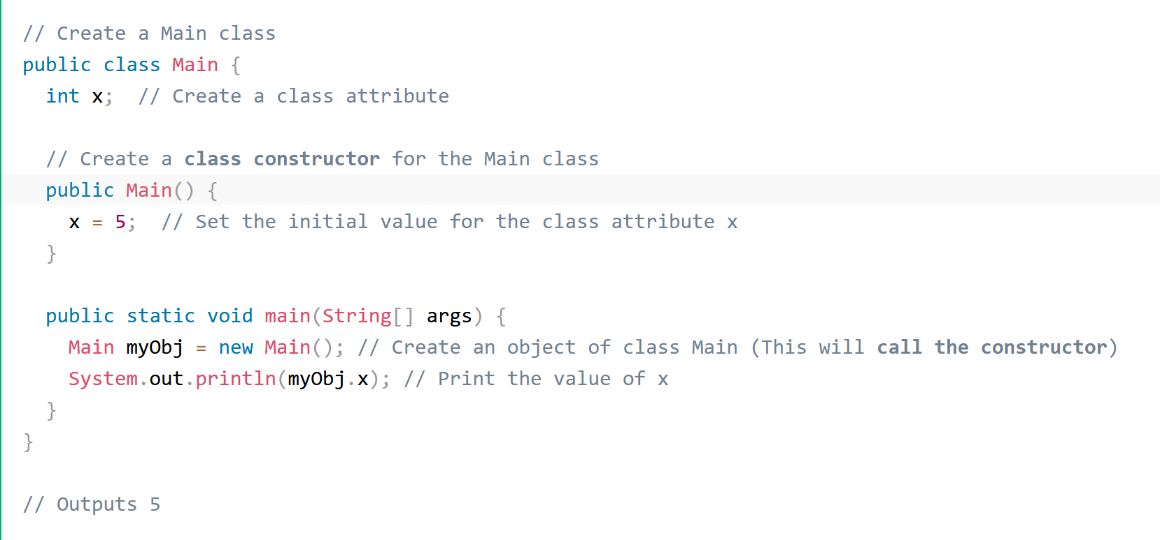
Constructors
A special method that is used to initialize objects.
The constructor is called when an object of a class is created.
It can be used to set initial values for object attributes:

Slide 52
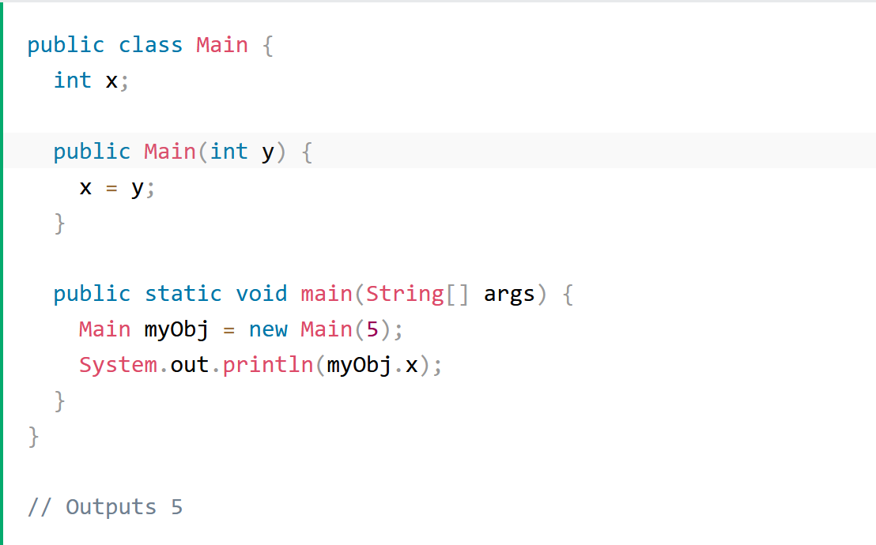
Constructor Parameters
Constructors can also take parameters, which is used to initialize attributes.

Slide 53
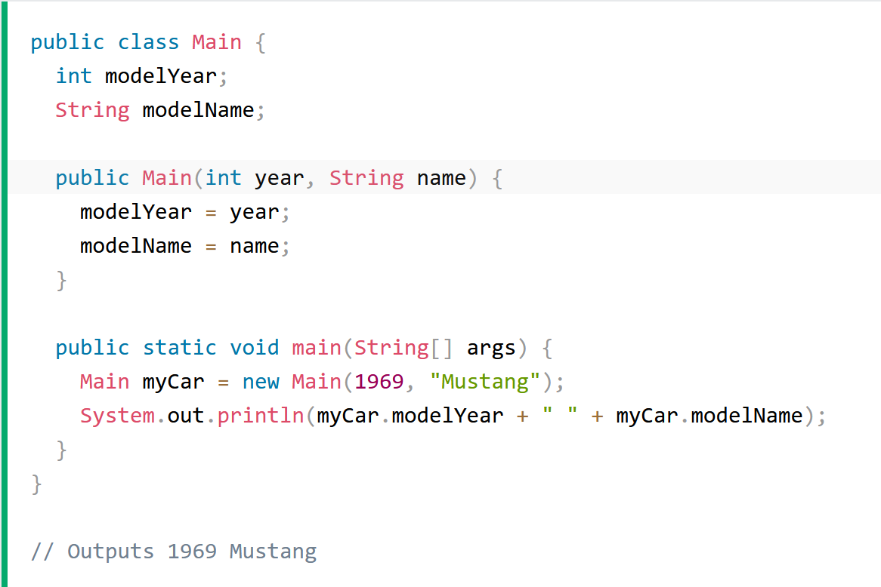
Multiple Parameters

Slide 54
Be careful!
A nasty bug:
public class MyClass
{
...
// Constructor:
public void MyClass (…)
{
...
}
...
Compiles fine, but the compiler thinks this is a method and uses MyClass’s default `no-args` constructor instead.

Slide 55
Passing data via parameters
Parameters are another sort of variable

Slide 56
Choosing variable names
There is a lot of freedom over choice of names … so use it wisely!
Choose expressive names to make code easier to understand:
price, amount, name, age, etc.
Avoid single-letter or cryptic names:
w, t5, xyz123

Slide 57
Accessor and Mutator
Methods implement the behavior of objects.
Methods have a consistent structure comprised of a header and a body.
Accessor methods provide information about an object
Mutator methods alter the state of an object.
Other sorts of methods accomplish a variety of tasks (e.g. Print methods)

Slide 58
Accessor (get) methods
return type
visibility modifier
method name
parameter list (empty)
public int getPrice()
{
return price;
}
return statement
start and end of method body (block)

Slide 59
Accessor methods
An accessor method always has a return type that is not void
An accessor method returns a value (result) of the type given in the header
The method will contain a return statement to return the value
NOTE: Returning is not printing!

Slide 60
Test
public class CokeMachine
{
private price;
public CokeMachine()
{
price = 300
}
public int getPrice
{
return Price;
}
What is wrong here?
(there are five errors!)

Slide 61
Test
public class CokeMachine
{
private price;
public CokeMachine()
{
price = 300
}
public int getPrice
{
return Price;
}
int
What is wrong here?
;
(there are five errors!)
()
-
}

Slide 62
Mutator methods
Have a similar method structure: header and body
Used to mutate (i.e. change) an object’s state
Achieved through changing the value of one or more fields
Typically contain one or more assignment statements
Often receive parameters

Slide 63
Mutator methods
visibility modifier
return type
method name
formal parameter
public void insertMoney(int amount)
{
balance = balance + amount;
}
field being mutated
assignment statement
Compound assignment operators (e.g. +=, -=, *=, /=)
balance += amount;

Slide 64
A typical set method
public void setDiscount(int amount)
{
discount = amount;
}
We can easily infer that discount is a field of type int:
private int discount;

Slide 65

String concatenation
4 + 5
9
"wind" + "ow"
"window"
"Result: " + 6
"Result: 6"
"# " + price + " cents"
"# 500 cents"
overloading
Notes:
try out in codepad

Slide 66
Java Scope
In Java, variables are only accessible inside the region they are created. This is called scope.
Method Scope
Variables declared directly inside a method are available anywhere in the method following the line of code in which they were declared.

Slide 67
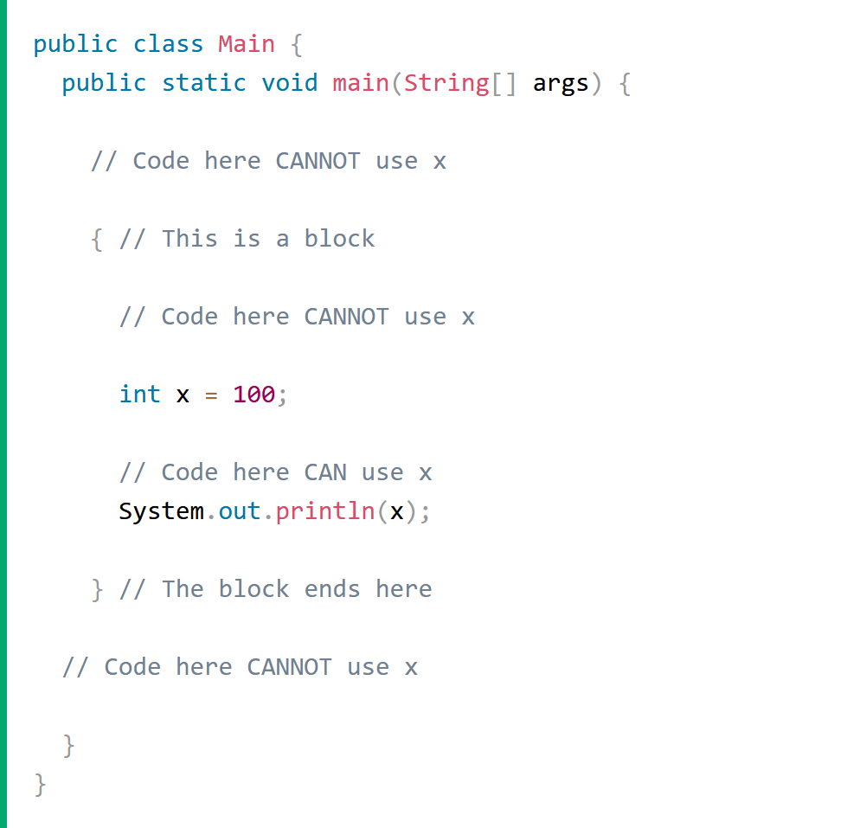

Slide 68
Local variables
A local variable
public int refundBalance()
{
int amountToRefund;
amountToRefund = balance;
balance = 0;
return amountToRefund;
}
No visibility
modifier

Slide 69
Scope and lifetime of variables
Fields
Scope: the entire class in which it was defined
Lifetime: existence time of its containing object
Parameters
Scope: method/constructor which it is declared
Lifetime: execution time of method/constructor in which it was declared/passed into
Local variables
Scope: the code block in which it was declared
Lifetime: the execution time of the code block in which it was declared and initialized in

